Slide 1
Trees and Binary Trees
Unit 4

Slide 2
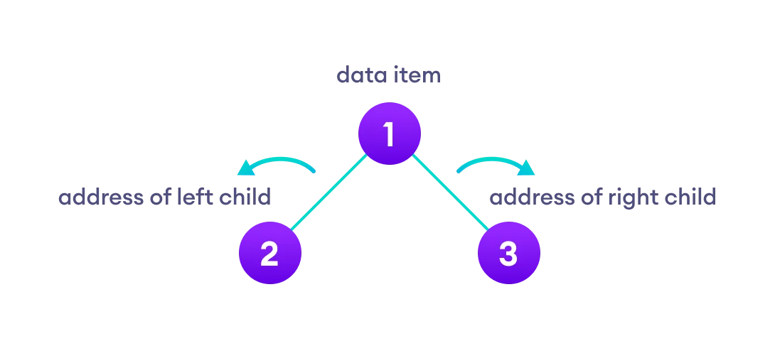
Trees and Binary Trees
A binary tree is a tree data structure in which each parent node can have at most two children. Each node of a binary tree consists of three items:
data item
address of left child
address of right child

Slide 3
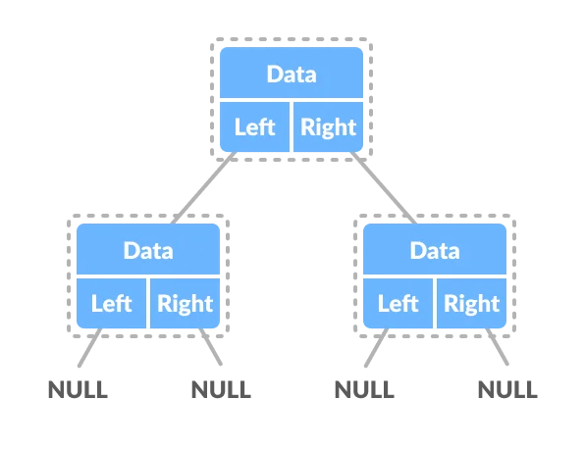
Trees and Binary Trees
Binary Tree Representation
A node of a binary tree is represented by a structure containing a data part and two pointers to other structures of the same type.
struct node
{
int data;
struct node *left;
struct node *right;
};

Slide 4
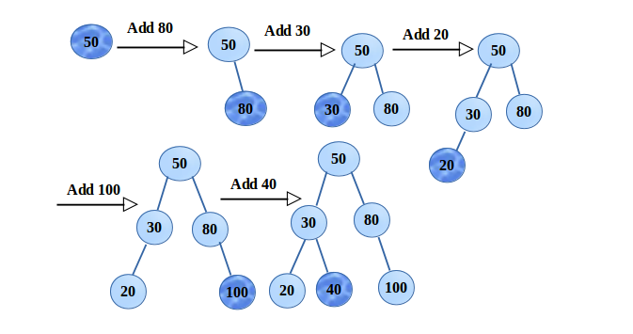
Trees and Binary Trees
Insertion
Say we have to build a BST of the keys, 50, 80, 30, 20, 100, 40. It can be clearly seen below, for inserting, first the key is compared is compared with the root, if smaller then go to Left sub tree else Right sub tree. The same step is repeated until all the keys are inserted.

Slide 5
Trees and Binary Trees
Algorithm
Create a new BST node and assign values to it.
2. insert(node, key)
i) If root == NULL,
return the new node to the calling function.
ii) if root=>data < key
call the insert function with root=>right and assign the return value in root=>right.
root->right = insert(root=>right,key)
iii) if root=>data > key
call the insert function with root->left and assign the return value in root=>left.
root=>left = insert(root=>left,key)
3. Finally, return the original root pointer to the calling function.

Slide 6
Trees and Binary Trees
Deletion
1.Leaf Node
If the node is leaf (both left and right will be NULL), remove the node directly and free its memory.
100 100
/ \ / \
50 200 delete(300) 50 200
/ \ /
150 300 150
If the node has only right child (left will be NULL), make the node points to the right node and free the node.
100 100
/ \ / \
50 200 delete(200) 50 300
\
300

Slide 7
Trees and Binary Trees
If the node has only left child (right will be NULL), make the node points to the left node and free the node.
100 100
/ \ / \
50 200 delete(200) 50 150
/
150
.Node has both left and right child
If the node has both left and right child,
1.find the smallest node in the right subtree. say min
2.make node->data = min
3.Again delete the min node.

Slide 8
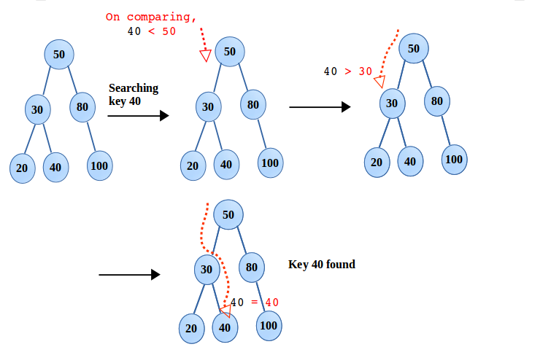
Trees and Binary Trees
(step 2)
100 100
/ \ / \
50 200 delete(200) 50 300
/ \ (right subtree min = 300 /
150 300 (step 1) 150
Searching
The steps follow in the insertion, are same followed here. Only difference is in comparison, if the key is not matched, repeat the steps till reached NULL. That says, desired key is not available in the BST.

Slide 9
Trees and Binary Trees
Traversing
Traversing is the process by which we can visit and access each and every element present in any data structure like an array, linked list, or tree. It is an operation which can be implemented on any data structure. Traversal is the most basic of the operations that can be performed on any data structure.
There are 3 tree traversals that are
Preorder Traversal
Inorder Traversal
Postorder Traversal
Inorder Tree Traversal
The inorder tree traversal of binary tree is also known as the LNR traversal, because in this traversal, we first visit the left node (abbreviation L), followed by the root node(abbreviation N), and finally the right node (abbreviation R) of the tree.

Slide 10
Trees and Binary Trees
The algorithm for the inorder traversal can be stated as:
Recursively traverse the current node's left sub tree.
Visit the current node.
Recursively traverse the current node's right sub tree.
In the case of binary search trees (BST), Inorder traversal gives nodes in non-decreasing order. To get nodes of BST in non-increasing order, a variation of Inorder traversal where Inorder traversal is reversed can be used.
Time Complexity: O(N)
Auxiliary Space: If we don’t consider the size of the stack for function calls then O(1) otherwise O(h) where h is the height of the tree.

Slide 11
Trees and Binary Trees
Preorder Tree Traversal
It is performed in a similar way as the inorder traversal is performed, but here the order of visiting the nodes is different than that of the inorder traversal.
In the case of the preorder traversal of binary tree, we visit the current node first. After that, we visit the leftmost sub tree. Once we reach the leaf node(or have covered all the nodes of the left sub tree), we move towards the right sub-tree. In the right sub tree, we recursively call our function to do the traversal in a similar manner.
The algorithm for the preorder traversal of binary tree can be stated as:
Visit the current node
Recursively traverse the current node's left subtree.
Recursively traverse the current node's right subtree.
procedure preorder(node)
if node = null
return
visit(node)
preorder(node.left)
preorder(node.right)

Slide 12
Trees and Binary Trees
Time complexity Analysis:
If a tree has n nodes, then each node is visited only once in the preorder traversal of binary tree, hence the complexity of the preorder traversal of the binary tree is O(n)
The space complexity of the recursive preorder traversal of binary tree is O(h) for a tree of height h.
Postorder Traversal
Postorder traversal of binary tree, where, we basically visit the left subtree and the right subtree before visiting the current node in recursion.
In a nutshell, postorder traversal of binary tree follows the following order of visiting the nodes in a tree:
Recursively traverse the current node's left subtree.
Recursively traverse the current node's right subtree.
Visit the current node (in the figure: position blue).

Slide 13
Trees and Binary Trees
procedure postorder(node)
if node = null
return
postorder(node.left)
postorder(node.right)
visit(node)
Time Complexity Analysis:
If a tree has n nodes, then each node is visited only once in the postorder traversal of binary tree, hence the complexity of the postorder traversal of the binary tree is O(n) .
The space complexity of the recursive postorder traversal of binary tree is O(h) for a tree of height h.

Slide 14
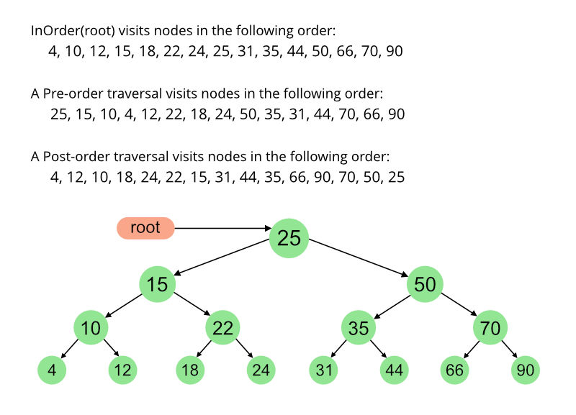
Trees and Binary Trees
Traversal | First | Second | Third
Inorder | Left | Root | Right
Preorder | Root | Left | Right
Postorder | Left | Right | Root

Slide 15
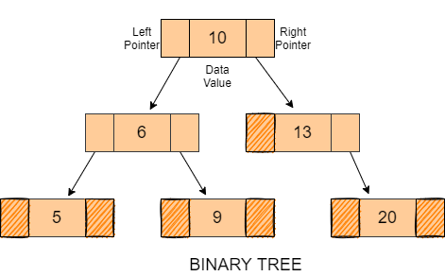
Threaded Binary Tree
In a threaded binary tree, either of the NULL pointers of leaf nodes is made to point to their successor or predecessor nodes
We know every node of the binary tree stores the data value of the node and the address pointers of the left and right children. If a node in a binary tree does not have a left or right child or is a leaf node, then the child node’s absence is represented by a null pointer.
Consider the following Binary Tree.

Slide 16
Threaded Binary Tree
Many nodes present in this tree hold a NULL value in their left or right child pointer (Denoted by sketched fields). The space occupied by these null values can be used to store some kind of valuable information.
One possible way to utilise this space is to have a special pointer that points to nodes higher in the tree (i.e. ancestors). These special pointers are called threads, and the binary tree having such pointers is called a threaded binary tree.
A Threaded Binary Tree is a variant of a normal Binary Tree that facilitates faster tree traversal and does not require a Stack or Recursion. It decreases the memory wastage by setting the null pointers of a leaf node to the in-order predecessor or in-order successor.
In a Threaded Binary Tree, the nodes will store the in-order predecessor/successor instead of storing NULL in the left/right child pointers.
So the basic idea of a threaded binary tree is that for the nodes whose right pointer is null, we store the in-order successor of the node (if-exists), and for the nodes whose left pointer is null, we store the in-order predecessor of the node(if-exists).
One thing to note is that the leftmost and the rightmost child pointer of a tree always points to null as their in-order predecessor and successor do not exist.

Slide 17
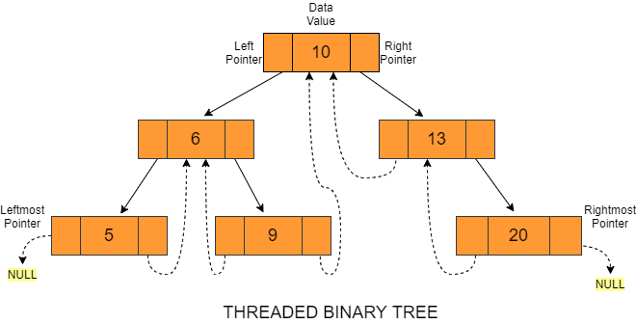
Threaded Binary Tree
To understand this, let’s look at an example of a Threaded Binary Tree.

Slide 18
Threaded Binary Tree
In the above-given figure, the right pointer of node value 6 points to 9.
Now, we will check the left pointer of node 9, and if it is NULL, then we modify the reference to the predecessor of the node, which is 6.
Then, we will check for the right pointer, and if it is also NULL, we will point it to the successor node, which is 10. Thus, it will point to 10.
We point to in-order predecessors/successors in left/right pointers using threads (denoted by dotted lines) as shown in the figure above, and that is why it is known as a Threaded Binary Tree.
Since the leftmost pointer of this tree is the left pointer of node value 5 and the rightmost pointer of this tree is the right pointer of node value 20, they both point to NULL.
The main idea behind setting such a structure is to make the inorder and preorder traversal of a binary tree faster without using any additional data structure (e.g. auxiliary stack) or memory for its traversal.

Slide 19
Threaded Binary Tree
Types of Threaded Binary tree
There are two types of Threaded Binary Trees:
Single-Threaded Binary Tree
In this type, if a node has a right null pointer, then this right pointer is threaded towards the in-order successor’s node if it exists.
Node Structure of Single-Threaded Binary Trees: The structure of a node in a binary threaded tree is quite similar to that of a binary tree, but with some modifications. In threaded binary trees, we need to use extra boolean variables in the node structure. For single-threaded binary trees, we use only the rightThread variable.
struct Node{
int value;
Node* left;
Node* right;
bool rightThread;
}

Slide 20
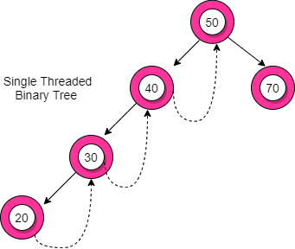
Threaded Binary Tree
The following diagram depicts an example of a Single-Threaded Binary Tree. Dotted lines represent threads.
In the figure given above, you can observe the node value 20 does not have any child nodes. So, the right pointer of node value 20 is null and therefore, it is pointing to its in-order successor (node value 30) through a thread. Similarly, the other nodes of this tree containing a right null pointer refer to their in-order successor, as shown.

Slide 21
Threaded Binary Tree
2. Double-Threaded Binary Tree
In this type, the left null pointer of a node is made to point towards the in-order predecessor node and the right null pointer is made to point towards the in-order successor node.
Node Structure of Double-Threaded Binary Trees: For the double-threaded binary tree, we use two boolean variables: rightThread and leftThread.
struct Node{
int value;
Node* left;
Node* right;
bool rightThread;
bool leftThread;
}

Slide 22
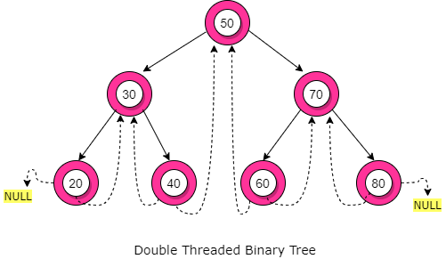
Threaded Binary Tree
This is how a Double-Threaded Binary Tree looks like. You can observe here that node value 40 have no left and right child. So, its left pointer points to its in-order predecessor (node value 30) and it's right pointer points towards its in-order successor (node value 50). Similarly, the other nodes of this tree with a left/right null pointer refers to their in-order predecessor/successor using threads.

Slide 23
Threaded Binary Tree
Advantages of Threaded Binary Tree
Let’s discuss some advantages of a Threaded Binary tree.
No need for stacks or recursion: Unlike binary trees, threaded binary trees do not require a stack or recursion for their traversal.
Optimal memory usage: Another advantage of threaded binary tree data structure is that it decreases memory wastage. In normal binary trees, whenever a node’s left/right pointer is NULL, memory is wasted. But with threaded binary trees, we are overcoming this problem by storing its inorder predecessor/successor.
Time complexity: In-order traversal in a threaded binary tree is fast because we get the next node in O(1) time than a normal binary tree that takes O(Height). But insertion and deletion operations take more time for the threaded binary tree.
Backward traversal: In a double-threaded binary tree, we can even do a backward traversal.

Slide 24
Binary Search Tree
The binary search tree is an advanced algorithm used for analyzing the node, its left and right branches, which are modeled in a tree structure and returning the value. The BST is devised on the architecture of a basic binary search algorithm; hence it enables faster lookups, insertions, and removals of nodes. This makes the program really fast and accurate.
A BST is made of multiple nodes and consists of the following attributes:
Nodes of the tree are represented in a parent-child relationship
Each parent node can have zero child nodes or a maximum of two subnodes or subtrees on the left and right sides.
Every sub-tree, also known as a binary search tree, has sub-branches on the right and left of themselves.
All nodes of left subtree are less than the root node
All nodes of right subtree are more than the root node
Both subtrees of each node are also BSTs i.e. they have the above two properties

Slide 25
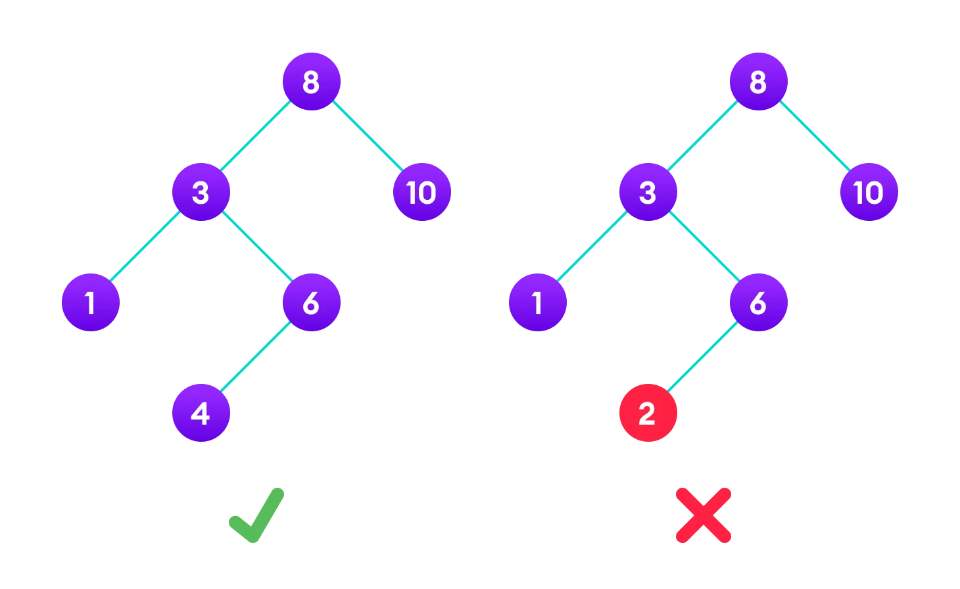
Binary Search Tree
The binary tree on the right isn't a binary search tree because the right subtree of the node "3" contains a value smaller than it.

Slide 26
Binary Search Tree
Search Operation
The algorithm depends on the property of BST that if each left subtree has values below root and each right subtree has values above the root.
If the value is below the root, we can say for sure that the value is not in the right subtree; we need to only search in the left subtree and if the value is above the root, we can say for sure that the value is not in the left subtree; we need to only search in the right subtree.
Algorithm:
If root == NULL
return NULL;
If number == root->data
return root->data;
If number < root->data
return search(root->left)
If number > root->data
return search(root->right)

Slide 27
Binary Search Tree
Insert Operation
Inserting a value in the correct position is similar to searching because we try to maintain the rule that the left subtree is lesser than root and the right subtree is larger than root.
Algorithm:
If node == NULL
return createNode(data)
if (data < node->data)
node->left = insert(node->left, data);
else if (data > node->data)
node->right = insert(node->right, data);
return node;

Slide 28
Binary Search Tree
Deletion Operation
There are three cases for deleting a node from a binary search tree.
Case I
In the first case, the node to be deleted is the leaf node. In such a case, simply delete the node from the tree.
Case II
In the second case, the node to be deleted lies has a single child node. In such a case follow the steps below:
Replace that node with its child node.
Remove the child node from its original position.
Case III
In the third case, the node to be deleted has two children. In such a case follow the steps below:
Get the inorder successor of that node.
Replace the node with the inorder successor.
Remove the inorder successor from its original position.

Slide 29
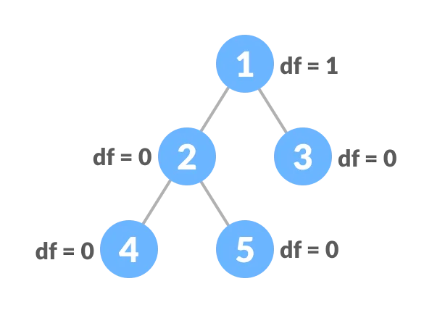
Balanced Binary Tree
A balanced binary tree, also referred to as a height-balanced binary tree, is defined as a binary tree in which the height of the left and right subtree of any node differ by not more than 1.
To learn more about the height of a tree/node, visit Tree Data Structure.Following are the conditions for a height-balanced binary tree:
difference between the left and the right subtree for any node is not more than one
the left subtree is balanced
the right subtree is balanced
Balanced Binary Tree with depth at each level

